Slide 1
RESEARCH PAPER PRESENTATION
TRIAD OF FRAGILITY
Food Price Volatility, Inflation Dynamics, and
Monetary Policy Transmission in Sub-Saharan Africa
Presenter: Usman Moses Okpanachi | Institution: Central Bank of Nigeria

Slide 2
PRESENTATION OVERVIEW
Road Map
01
Motivation & Problem
02
Literature Gap
03
Framework & Data
The interlocking triad of SSA fragility
What prior work misses
Model, classification, and methodology
04
Key Findings
05
Policy Recommendations
06
Conclusion
Pass-through, inflation dynamics, and transmission
Macroeconomic Stabilisation roadmap
Contributions

Slide 3
KEY MESSAGES
Four Key Messages from the Paper
Mutually Reinforcing Triad
01
The 3 elements of the triad are not just correlated in SSA, they are mutually reinforcing - > Self-sustaining cycles of macro fragility.
Apply demand-side tools with caution – food system stabilization is key
02
Inflation in fragile and post-conflict SSA economies is largely structural and food price-driven, not demand-driven. Monetary policy maneuvers cannot offset food supply shocks. Stabilising food systems — agricultural productivity, storage, trade facilitation, climate resilience — should be a major component of inflation stabilisation strategy.
Central banks should adopt context-specific frameworks
03
Owing to shallow financial systems, high informality, excess liquidity, and severely impaired transmission, interest rate adjustments have limited influence on inflation in FCS & Post-conflict SSAs. Central banks should adopt context-specific frameworks — and avoid aggressive tightening in response to supply-side shocks generally.
Sequence reforms: Breaking the triad of fragility requires sustained structural rebuilding
04
First restore food supply systems and basic financial intermediation, deepen financial inclusion and institutional capacity, and then more ambitious monetary policy mechanisms.
Breaking the triad of fragility requires sustained structural rebuilding, not short-term policy adjustments.
Bottom line: in fragile SSA, fix the food system and rebuild transmission capacity first — orthodox monetary policy works when the transmission mechanism works. Reforms matter a great deal!

Slide 4
01 MOTIVATION
The Interlocking Triad of SSA Fragility
Food Price
Volatility
Persistent
Inflation
MUTUALLY
REINFORCING
Monetary Policy Transmission
Shutdown
(Unable to anchor inflation expectation)
Supply-driven, structural,
persistent shocks
High food-CPI share
amplifies pass-through
Transmission severely
impaired or perverse
Neither standard inflation-targeting frameworks nor conventional fiscal responses can adequately address this self-sustaining cycle.

Slide 5
01 MOTIVATION
Why SSA Economies Are Structurally Exposed
Rain-fed agriculture
Thin domestic markets
🌾
📦
<6% of cultivated area is irrigated — extreme sensitivity to rainfall anomalies
~40% post-harvest losses from inadequate storage & transport (WFP 2023)
High food-CPI weight
Large informal sector
🏠
💰
Food = 40–60% of CPI vs. 10–20% in advanced economies (IMF 2022)
35–65% of GDP is informal — outside monetary policy's reach (Medina & Schneider 2018)
Shallow finance
Conflict & fragility
🏦
⚔️
Private credit <10% GDP in Fragile & Crisis Affected States; oligopolistic banks with excess reserves
8 of the 36 SSA economies studied are classified FCS — disrupt supply chains & institutions (World Bank, 2022; Fund for Peace Fragile States Index, 2022)

Slide 6
02 LITERATURE GAP
Three Siloed Research Streams
Stream 1
Stream 2
Stream 3
Food Price Transmission
Inflation Determinants
Monetary Transmission
Key works
Key works
Key works
Minot (2014)
Baquedano & Liefert (2014)
Baldini & Poplawski-Ribeiro (2011)
Kabundi et al. (2022)
Mishra & Montiel (2013)
Davoodi et al. (2013)
Gap
Gap
Gap
Focuses on market integration & price co-movement without linking to monetary policy efficacy
Treats monetary transmission as a background assumption rather than an object of inquiry
Has not fully grappled with how food-price dominance in CPI reshapes transmission channels
➜ THIS PAPER: treats the triad as a unified analytical object with focus on fragile & post-crisis SSA economies

Slide 7
03 FRAMEWORK & DATA
Classifying 36 SSA Economies into Three Groups
Triple-Criterion Classification (meet ≥ 2 of 3)
① World Bank Harmonised FCS List ② Fragile States Index > 90 ③ UCDP armed conflict ≥ 25 deaths/yr
PANEL A
PANEL B
PANEL C
Fragile & Conflict-Affected
(FCS)
Post-Crisis Recovery
Economies
Stable Economies
(Reference)
N = 8
N = 12
N = 16
Countries:
Countries:
Countries:
Chad | DR Congo | Sudan Burundi | Niger Mali | Mozambique | Madagascar
Sierra Leone | Liberia | Guinea | Ethiopia |
Rwanda | Congo, Rep. | Malawi | Burkina Faso | Togo | Gambia | Mauritania | Cabo Verde
Botswana | Cabo Verde | Ghana |
Kenya | Mauritius | Namibia | Nigeria |
Senegal | South Africa | Tanzania | Uganda |
Zambia | Lesotho | Botswana | Gabon | Côte d'Ivoire
Post-Crisis: FCS-classified countries off World Bank list for ≥ 3 consecutive years by 2022

Slide 8
03 FRAMEWORK & DATA
Theoretical & Empirical Model
Modified the New Keynesian small open economy model of Galí and Monacelli (2005)
Food Price Pass-through to Domestic Inflation
Baquedano and Liefert (2014)
autoregressive distributed lag (ARDL) for long-run pass-through elasticities.
Panel inflation equations
Regressed Headline/Core inflation on food price shocks, the country-specific pass-through estimates from stage one, and their interactions with the transmission efficiency index (GMM).
Alternate
- Headline (Base effect)
- Core (2nd Round Effect)
Determinants of Transmission Efficiency
Regressed the Transmission efficiency on financial development, informality, Banking sector holdings of government securities, and their interactions with food price volatility (GMM)
Sensitivity
Local Projection
dynamic inflationary impact of food price shocks under varying transmission regimes
Transmission efficiency recovery
When Φ → 0 (shutdown): raising the policy rate yields zero or perverse inflation response.

Slide 9
SUMMARY OF FINDINGS
Key Results
0.31
0.58
+0.08
0.41
17 yrs
Policy rate effect on π (FCS h=1yr)
Stable economies = -0.16
FCS mean Φ
FCS pass-through
Food → core inflation (FCS)
To reach SSA median Φ (no IMF)
Transmission nearly shut down in FCS
Food price pass-through is highest in FCS
Monetary tightening is perverse in FCS
Strong second-round effects in fragile states
Recovery is slow — IMF support halves it
Average monetary policy transmission efficiency is 0.31 in fragile states vs. 0.58 in stable economies and 0.46 for post-crisis.
FCS show highest food price pass-through to domestic inflation compared to stable (0.32) and post-crisis (0.46) economies.
Raising the policy rate has zero or positive inflation effects in FCS. In active conflict, tightening may raise inflation through fiscal dominance.
Food inflation passes into core inflation at 0.41 in FCS vs. 0.18 in stable economies. Weak credibility means high food prices de-anchoring of inflation expectations.
Post-conflict Φ recovery takes ~17 years without sustained support, but IMF-supported programmes can accelerate this to ~6 years.
Policy implication: Conventional monetary tightening is contraindicated in FCS and early post-crisis economies — supply-side stabilisation and financial sector reconstruction must come first.

Slide 10
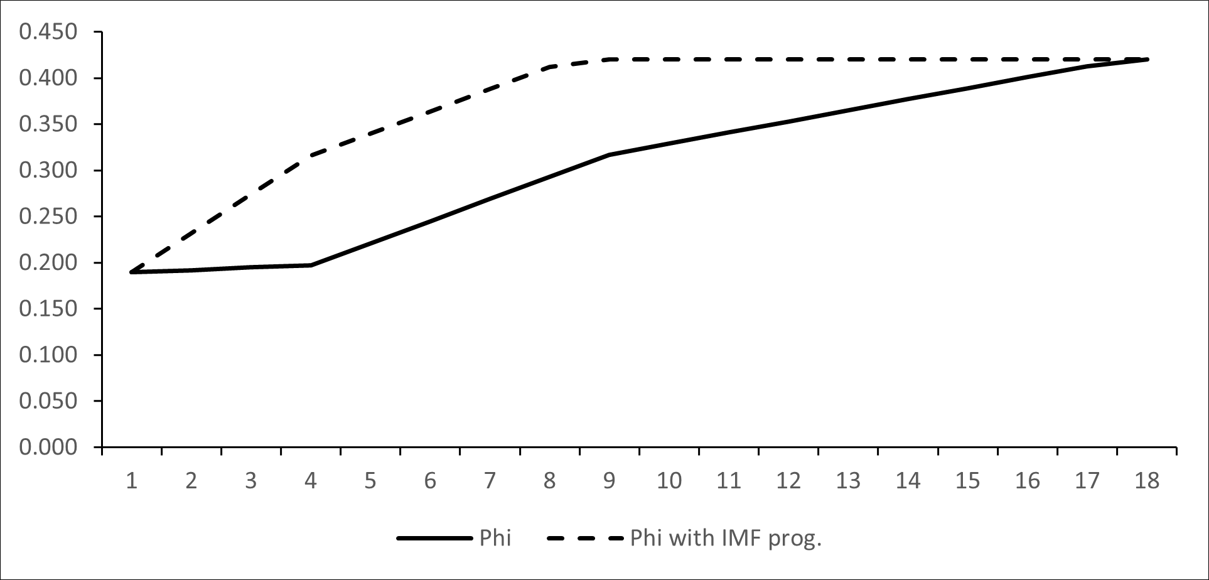
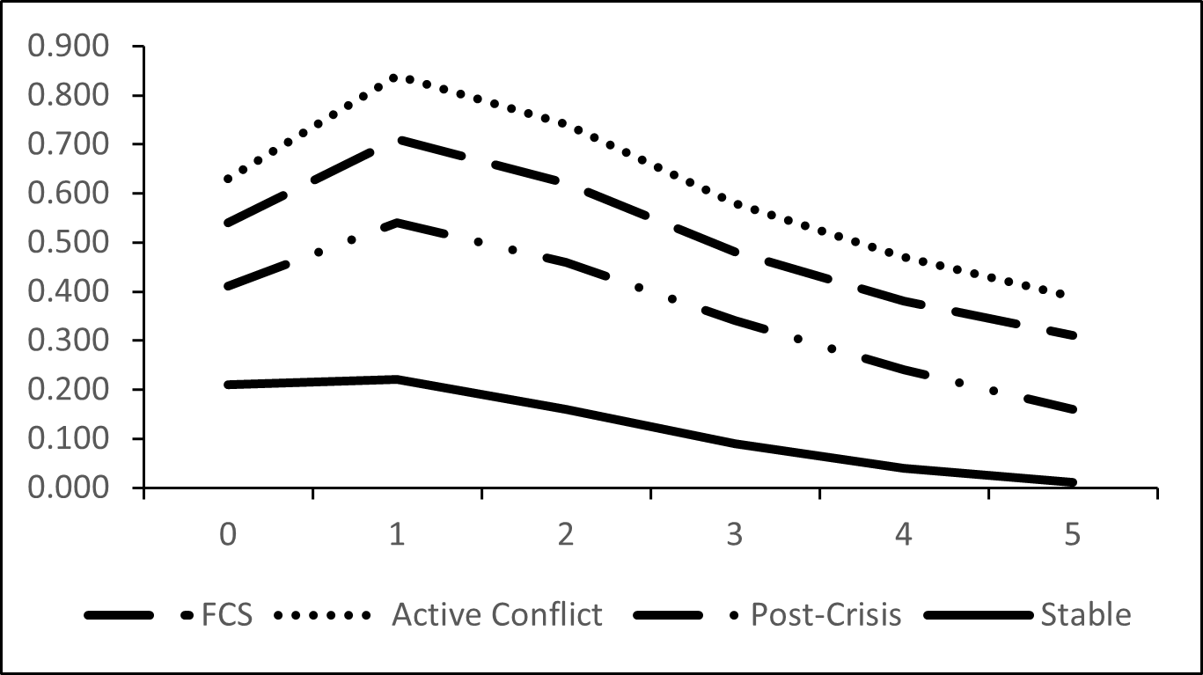
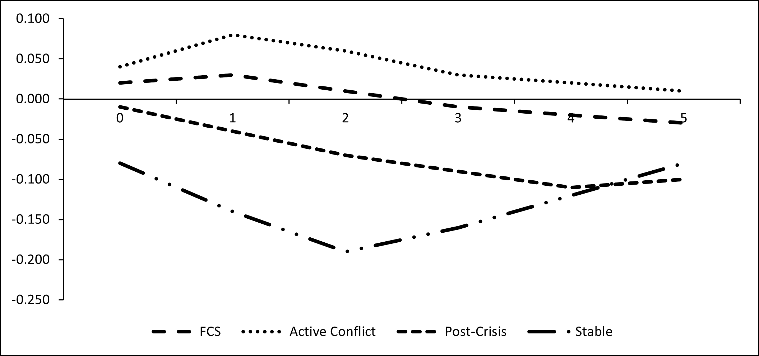
SUMMARY OF FINDINGS Cont’d
Key Results
01
Transmission Efficiency Trajectory
02
Inflation response to global food price shock
03
Inflation response to monetary policy tightening

Slide 11
POLICY RECOMMENDATIONS
What Must Change — and in What Order
01
FOOD
02
MONY
03
FIN
04
SEQN
05
IMF
Food System Stabilisation as Primary Inflation Instrument
Recalibrate Monetary Frameworks for Low-Transmission Environments
Rebuild Financial Sector as Transmission Precondition
Sequence Reforms by Stage of Fragility
Reform Intervention Programme Design for Fragile Contexts
> Invest in rural infrastructure & storage to cut post-harvest losses
> Shift from headline to core inflation targeting — exclude exogenous food shocks
> Expand digital & mobile banking to raise financial inclusion (target >15% adults)
> Immediate (conflict): restore food supply & basic financial functionality first
> Replace headline CPI conditionality with core inflation indicative targets in FCS
> Build strategic food reserves to buffer temporary price shocks
> Prioritise exchange rate stability & liquidity management over rate hikes
> Reduce bank holdings of govt securities that crowd out private credit (FCS avg 18%)
> Medium-term: deepen inclusion, reduce excess liquidity, build institutions
> Add transmission efficiency (Φ) as an explicit structural benchmark
> Facilitate food imports via targeted trade policy in crisis periods
> Avoid aggressive tightening: it imposes output costs without price stability gains
> Strengthen credit allocation mechanisms to support private sector lending
> Late recovery (Φ > 0.42): only then reintroduce inflation targeting
> Extend programme horizons beyond the typical 3–5 yr window
> Promote climate-resilient agriculture to reduce rainfall-driven volatility
> Strengthen central bank communication & forward guidance to anchor expectations
> Formalise economic activity to lift agents' responsiveness to policy signals
> Policy instruments must match the structural capacity of the economy
> Incorporate food system & structural resilience metrics into programme evaluation
Food shocks → headline CPI: FCS coef. 0.52*** vs Stable 0.26***
Policy rate coef. = +0.09* in FCS — tightening may raise inflation
Financial development coef. = 0.22*** — largest driver of Φ recovery
Φ recovery: 17 yrs without IMF support → ~6 yrs with sustained IMF programme
IMF engagement coef. = 0.042*** — well-designed programmes restore transmission
Inflation in fragile SSA is structural, not purely monetary — effective stabilisation requires food system intervention, financial reconstruction, sequenced institutional rebuilding, and reformed international support frameworks.

Slide 12
CONCLUSION
What This Study Establishes
01
TRIAD
02
TRANSMISSION
03
EXPECTATION DE-ANCHORING
04
TRANSMISSION EFFICIENCY RECOVERY
A Self-Reinforcing System, Not Isolated Phenomena
Monetary Transmission Is Near-Complete Shut Down in FCS
Food Prices De-anchor Expectations, Driving Persistent Core Inflation
Recovery Is Slow but Achievable — IMF Engagement Matters
> Food price shocks, inflation persistence, and transmission shutdown are mutually reinforcing
> Mean Φ = 0.31 in FCS vs 0.48 in stable economies
> Food → core inflation: 0.41 in FCS vs 0.18 in stable economies
> Post-conflict Φ recovery averages 0.024 units/yr — SSA median takes ~17 years
> FCS economies show the highest amplification across all three dimensions simultaneously
> Conventional tightening has zero or perverse inflation effects in fragile settings
> Weak institutional credibility means agents form expectations from food prices alone
> IMF-supported programmes compress recovery to ~6 years (coef. = 0.042***)
> No single element can be addressed in isolation — all three must be tackled together
> Shallow finance, high informality, and conflict jointly disable all transmission channels
> Every food price shock propagates into wages and pricing, outlasting the original shock
> A paradigm shift is needed: structural interventions must precede orthodox policy
Food shock coef.: FCS 0.52*** vs Stable 0.26*** — fragility amplifies directly
Real policy rate coef. = +0.09* in FCS — tightening may raise inflation
Second-round coef. more than doubles from stable to FCS settings
Years Since Conflict End coef. = 0.018** — recovery is gradual but real
The triad of fragility is a binding constraint on macroeconomic stabilisation — breaking it requires rethinking both the objectives and instruments of policy, integrating structural, institutional, and sectoral dimensions.

Slide 13
Thank You

