Slide 1
SUB-SAHARAN AFRICA’S
URBAN AWAKENING
Catalyzing Economic Growth and Job Creation
PREVIEW PRESENTATION
July 30, 2026
7th Africa Emerging Markets Forum
Abuja, Nigeria

Slide 2
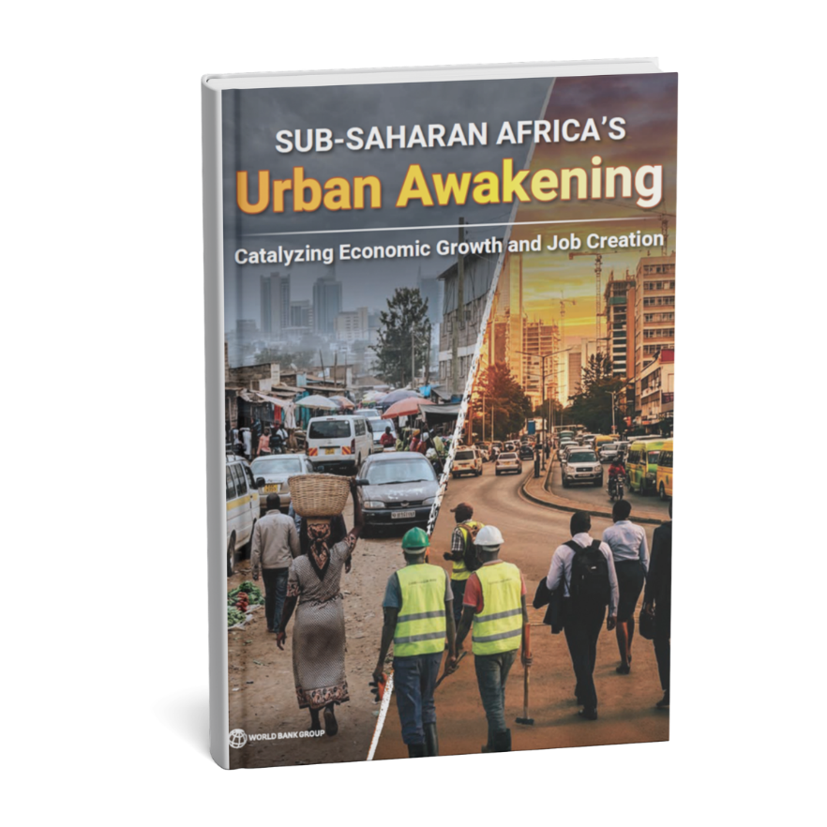
A preview of the forthcoming flagship report from the World Bank Group
  Applies a jobs lens to three distinct policy spaces: cities, rapidly growing peripheries & towns
  Identifies fit-for-purpose priorities that deliver now — drawing on local, partner & academic expertise
  Echoes this Forum’s Africa 2050 vision of jobs & convergence
  Official publication & launch: Fall 2026

Slide 3
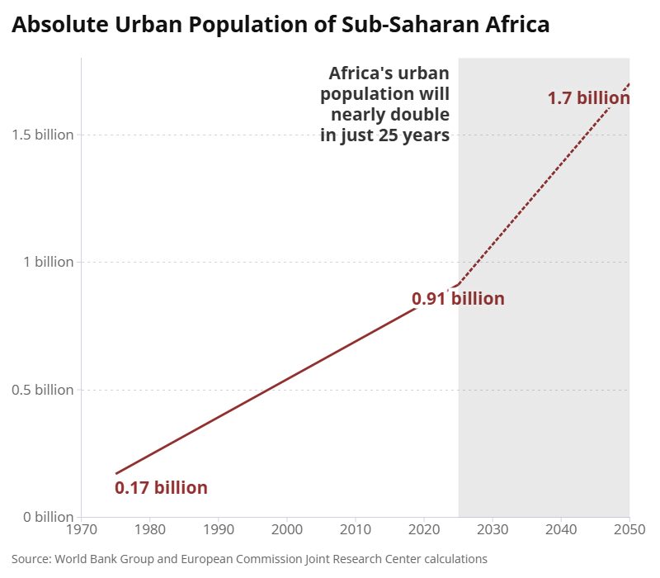
Time is running out to leverage SSA’s rapid urbanization
SSA is urbanizing at unprecedented speed & scale
Urbanization will be nearly complete by 2050
Urbanization has not yet enabled economic growth
Average GDP per capita around $4,400
Well-managed urbanization can be a catalyst for job creation
SSA requires 15 million new jobs per year

Slide 4




Well-managed urbanization can be a catalyst for productivity & structural transformation
Creating manufacturing & services jobs
Deeper labor markets with better matching
More diverse pools of local suppliers
Increased knowledge spillovers
Doubling of urban density is associated with a
∼17% increase in wages (Henderson et al., 2021)

Slide 5

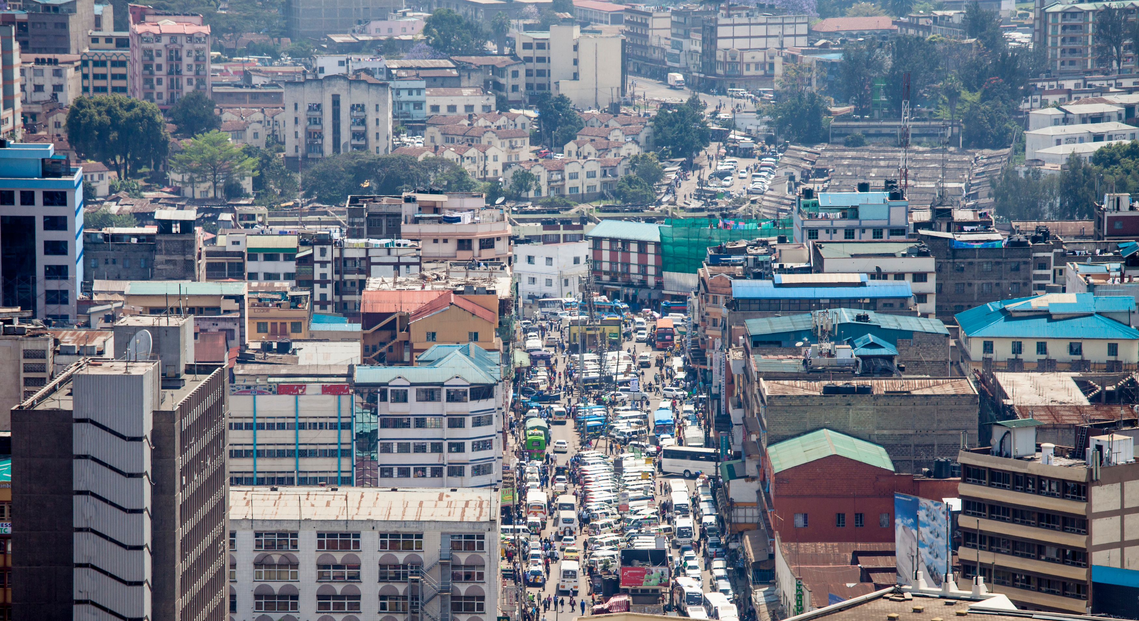
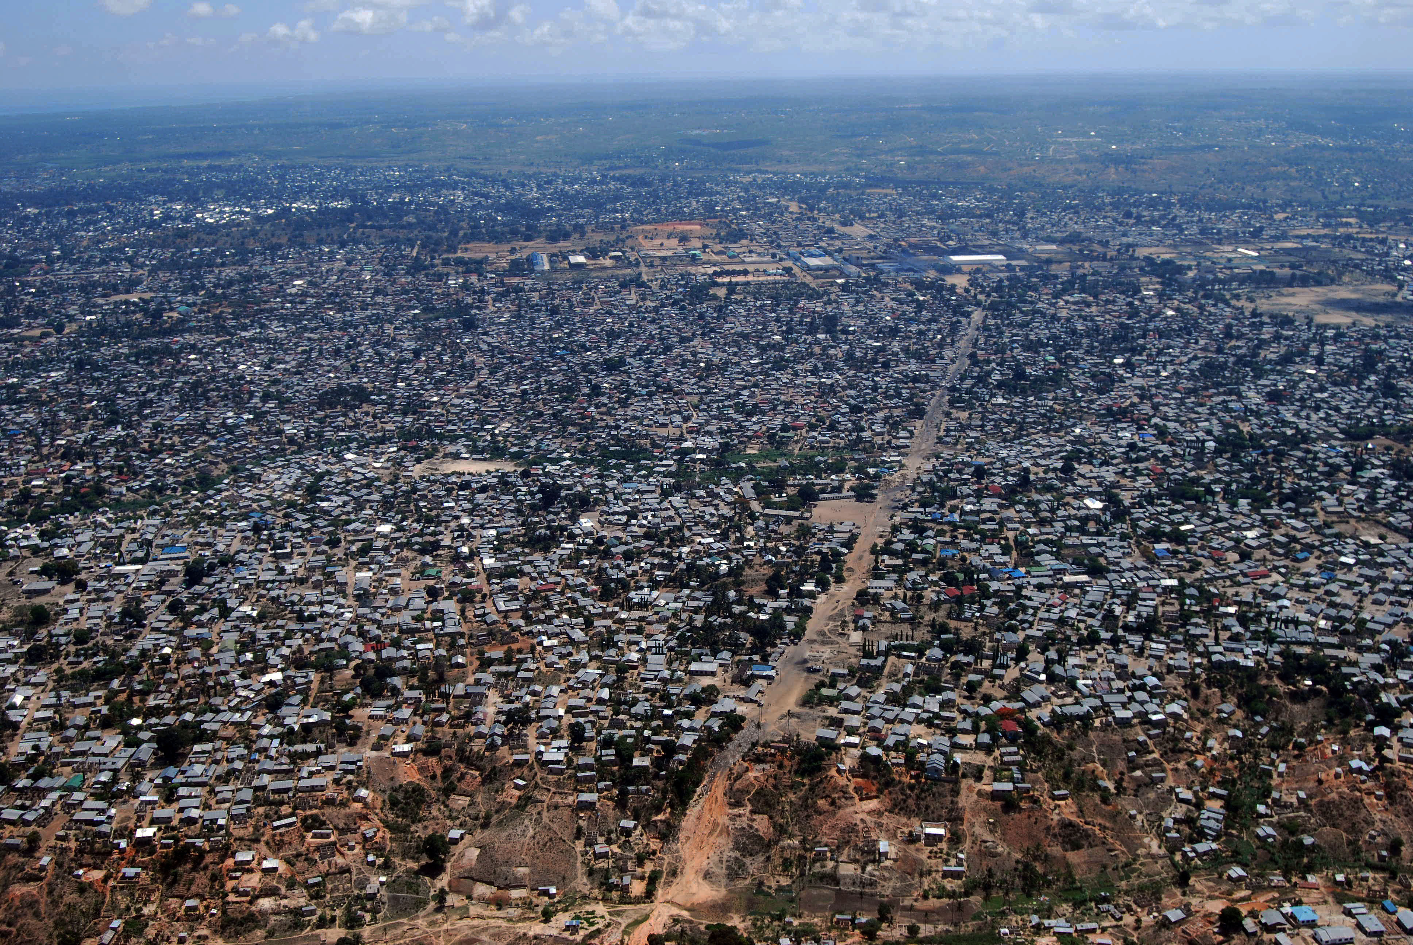
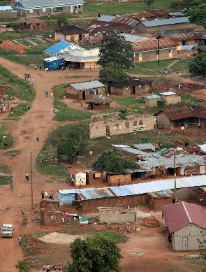
Three types of urban areas— three different policy responses
CITIES
PERIPHERIES
TOWNS
1
2
3
Absence of job-rich clustering
Inadequately prepared for rapid expansion
Small, still partly rural, & too often ignored
Foundational Infrastructure
Regulatory Environment
Private Capital Mobilization
Lack of authority, ability, and resources

Slide 6
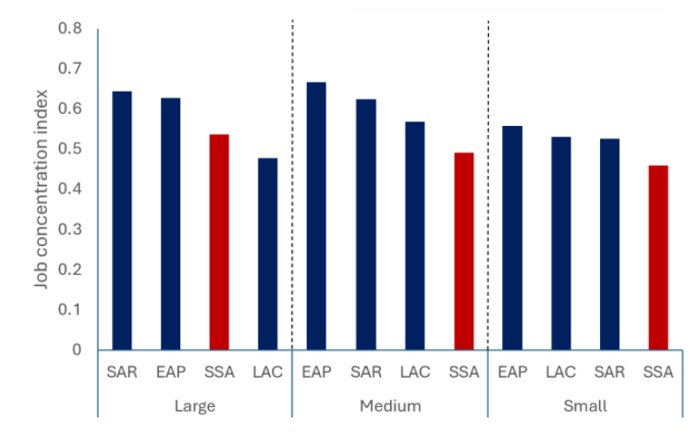
Job concentration index,
Sub-Saharan Africa and selected other regions
CITIES
1
Absence of job-rich clustering
Source: Calculations based on data for predicted employment generated by University College London and the World Bank Group Global Facility for Disaster Reduction and Recovery (GFDRR) using the machine learning algorithm developed by Barzin et al. 2022.

Slide 7
Cities: Investments in infrastructure & regulatory reforms to facilitate jobs-rich clusters and crowd-in private sector
Medium-term
Long-term
Part 1
Part 2
Part 3
Objective
Investment/
Reform Areas
Examples
Promote Job-Rich Clusters
Connect Workers & Housing to Jobs
Strengthen Financing & Funding
Integrated area (re-) development
Public-private partnerships
Human capital investments
Intra-city transport corridors
Integrating informal transport services
Access to affordable housing
Land & property rights
Land-based financing to strengthen revenues & unlock private capital
Credit worthiness
Nairobi Railway City
Victoria & Albert Waterfront, Cape Town
Lagos transport reform
Cape Town’s backyarder program
Freetown’s property tax reform
Addis Ababa’s infra financing

Slide 8
Projected growth in total population and land area in cities by region, 2025–2050
PERIPHERIES
2
Inadequately prepared for rapid expansion
Source: World Bank Group and European Commission Joint Research Center calculations

Slide 9
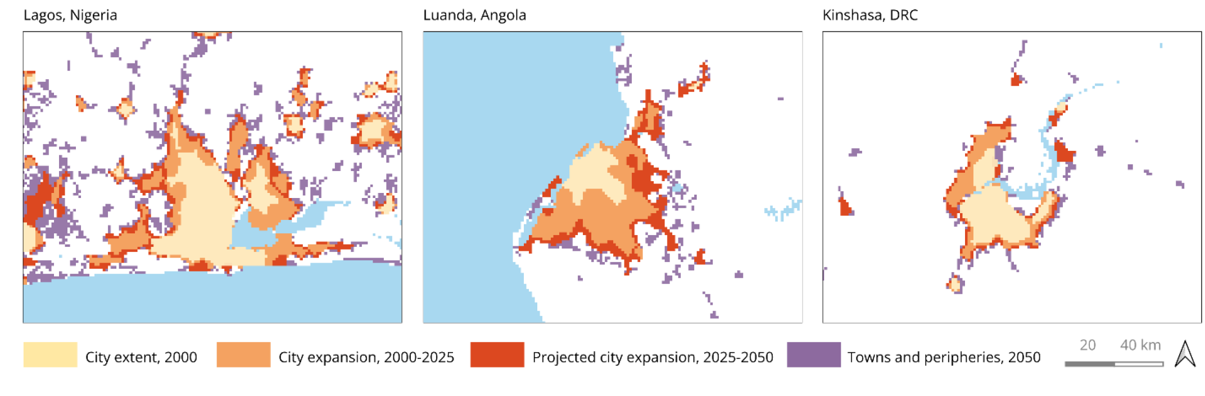
Peripheries: Inadequately prepared for rapid expansion
Urban expansion patterns for Sub-Saharan Africa’s
three most populous cities
Source: World Bank Group and European Commission Joint Research Center calculations.

Slide 10
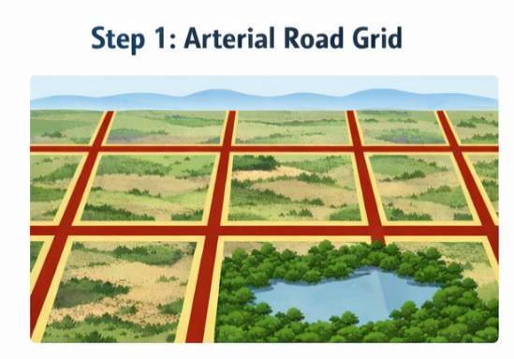
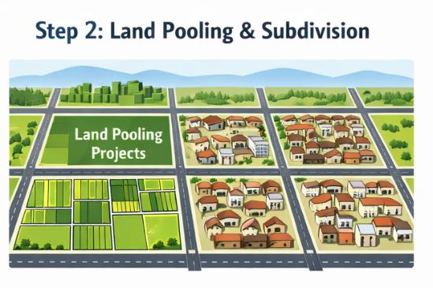
Peripheries: Two–pronged approach to prepare for near doubling of area
1) Plan & invest in arterial grid
Grid creates future macro-structure
Plan & invest in roads – approx. 30 m wide & 1 km apart
Reserve & enforce “no-build” zones
Rights of way also important for utility networks
Arterial grid with “no-build” zones
2) Facilitate land pooling & subdivision
Land contributed to common pool
Pooled area planned; some land used for infrastructure
Remaining land subdivided & allocated back
Facilitates land value capture
Work with customary authorities
Land pooling & subdivision

Slide 11
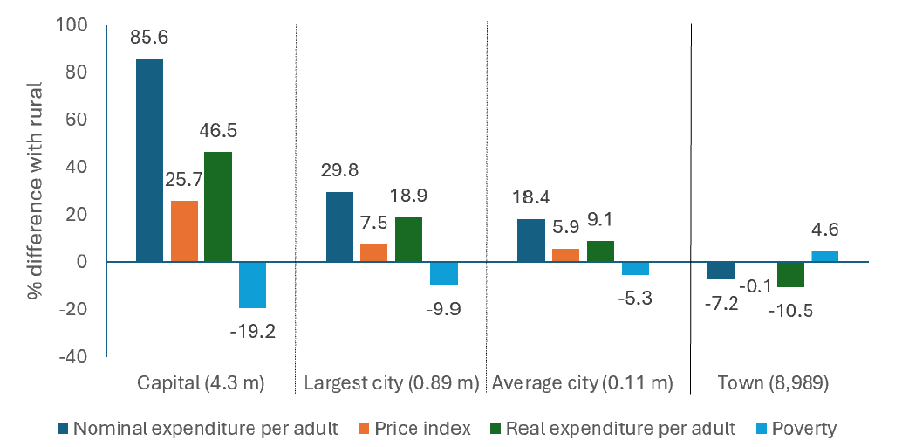
Expenditure per adult and price indices
in urban relative to rural areas, 13 SSA countries
TOWNS
3
Small, still partly rural, and too often overlooked
Source: World Bank Group calculations based on Combes, Nakamura, and Roberts (2026) for this report

Slide 12
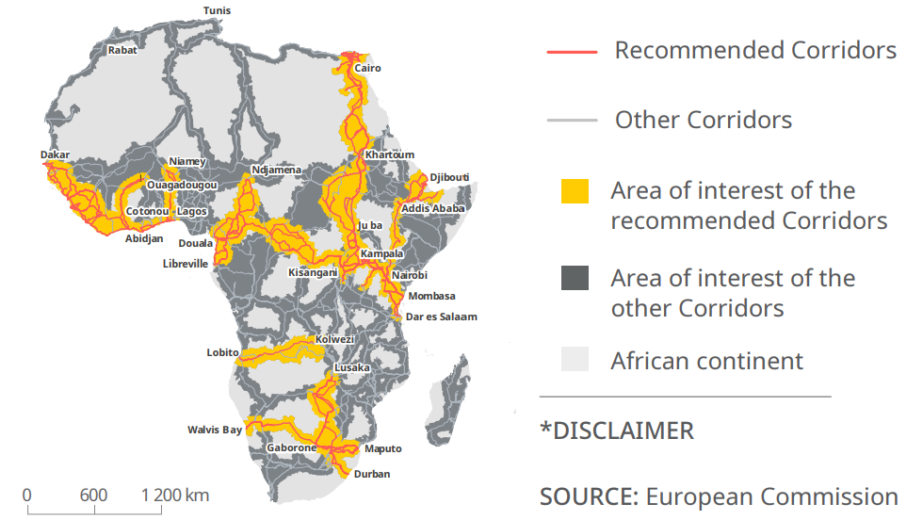
Towns: Adopt tailored approach based on underlying economic potential
EU-Africa Envisaged Strategic Corridors
High-potential towns
Strong locational fundamentals
Place-based policies
Possible admin re-classification
Small investments help unlock full corridor potential
Low-potential towns
Weaker fundamentals
Focus on basic services & connectivity

Slide 13
Managing, financing & governing SSA’s rapid urbanization
1
2
3
Authority
Powers to implement change
Special jurisdiction decentralization in highly centralized settings
E.g., Lagos State; Kampala Capital City Authority
Ability
Capacity and skills to enact change
Ethiopian Civil Service University (ECSU) program to prepare for urban expansion
Dar Es Salaam Metro Development Project
Resources
Resources to enact change & build capacity
E.g., Freetown’s 2018 property tax reform
Improved design of transfer systems

Slide 14





THANK YOU TO OUR SUPPORTERS & PARTNERS

Slide 15


COMING FALL 2026
SCAN TO SUBSCRIBE
worldbank.org/urban

Slide 16
Closing reflections: seizing a time-bound opportunity
The window of opportunity is rapidly closing
This decade’s choices will echo for generations
The challenges are real, but the strategy is clear
Tailored policies for cities, peripheries & towns
Ambition & selectivity: a lasting engine of growth
Delivering more & better jobs at scale

