Slide 1
Artificial Intelligence and Economic Development
Indermit Singh Gill
Chief Economist, World Bank Group
Based on work by World Bank economists
7th Africa Emerging Markets Forum
Abuja
July 29, 2026

Slide 2
Outline
Mindset: Developing countries should be optimistic about AI
  Because the effects and opportunities are not the same as in advanced economies
Strategy: Mainstay of AI approaches should be adaptation
  AI is especially context-specific and adoption from abroad will not be sufficient
  AI is especially fast-moving and developing countries cannot wait for the resources required for advancement of the technology
Policy: Making choices in enabling, using and regulating AI
  To enable, provide the infrastructure and skills for ‘Small AI’ investments
  In use, emphasize predictive AI in back-end of social services
  To regulate sensibly, first encourage voluntary industry-led AI standards

Slide 3
Main implications for developing countries
  AI economic impacts not the same as in advanced economies
    Dangerous to extrapolate from concerns being debated in the US and Europe
    Developing countries should be more optimistic and aggressive about AI’s potential
  AI technologies even more context-specific than earlier GPTs
    ‘Middle powers’ should adopt a sensible mix of adoption, adaptation, and advancement
    Adaptation will have to be the main objective in developing countries
  AI strategies in developing countries involve cost-conscious choices
    Social services: Generative AI front-line use or predictive AI back-end use ?
    Economic impact: Big concentrated investments or small diffused investments ?
    Political risks: Government-imposed mandatory regulations or industry-led voluntary standards ?

Slide 4
What makes AI the same as other GPTs─and what makes it special
AI is a general-purpose technology, like the last three GPTs
  Artificial Intelligence is a transformative GPT, like electricity, computers and the internet
  Main differences relative to previous GPTs are greater speed and context-specificity
  Countries that gain most from GPTs invested early in infrastructure, skills, and institutions
AI’s development impact depends on the three Cs
  Capabilities central because AI both requires expertise and can fill expertise gaps
  Concentration since a few firms and countries control advanced systems and hardware
  Complements needed include analog foundations like electricity, ICT, and skills
AI’s benefits come from a balance among the three A’s
  Adopting readily available AI solutions and integrating them into widespread local use
  Adapting and fine-tuning these AI tools to their context, e.g., training on local languages
  Advancing frontier AI technology is a resource-intensive endeavor feasible for only a few.

Slide 5
AI effects in developing economies
Widespread but misplaced pessimism
  Europe and the Americas versus Asia and Africa
  Comes at a time of declining investment, output and productivity growth
Benefits are bigger in developing economies
  Lower displacement of labor in private sector
  Great potential in the provision of public services
Different from earlier GPTs
  Potential gains in productivity between ICT and Electricity
  Quicker diffusion and greater context-specificity

Slide 6
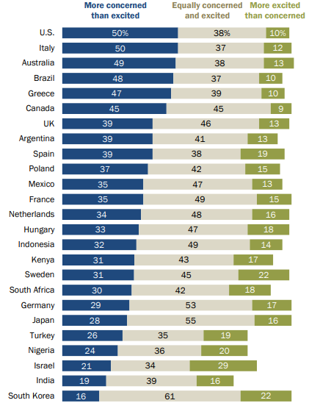
People in Europe and the Americas are worried, in Asia and Africa excited
Share who say AI makes them feel …
People in Europe and the Americas are very worried about AI
People in Asia and Africa seem to be more excited about AI
Source: Pew Research Center, Spring 2025 Global Attitudes Survey.

Slide 7
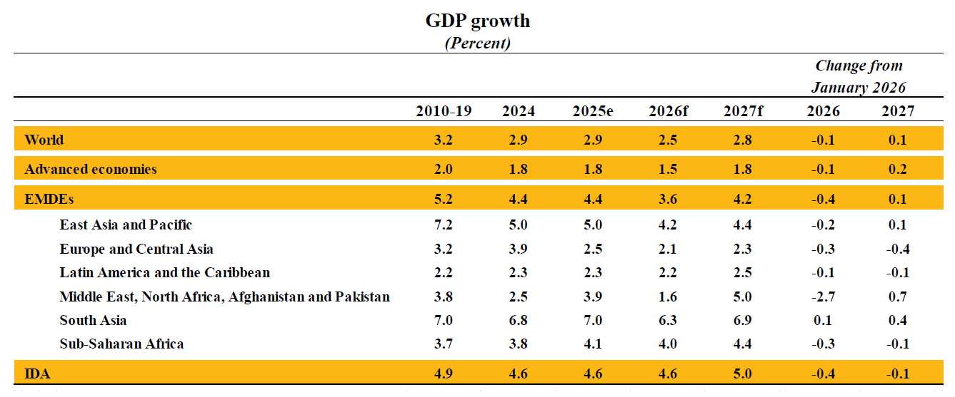
Immediate growth prospects are not good
Source: Global Economic Prospects, June 2026

Slide 8
Longer-term growth prospects are not good
Potential GDP growth
(annual percent)
Source: Kose and Ohnsorge (2023).
Note: Period averages. Potential growth is measured by production function. 2022-30 indicates forecasts.

Slide 9
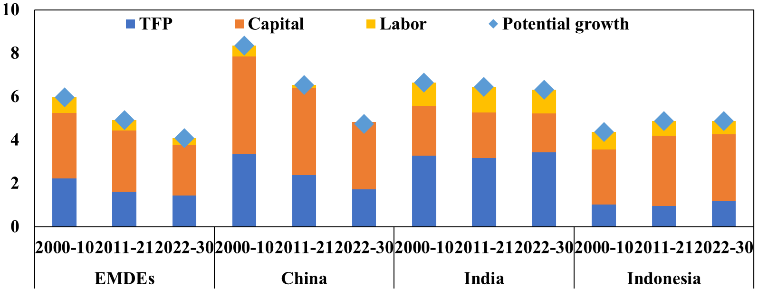
Declining productivity growth in emerging market economies
Potential GDP growth
(annual percent)
Source: Kose and Ohnsorge (2023).
Note: Period averages. Potential growth is measured by production function. 2022-30 indicates forecasts.

Slide 10
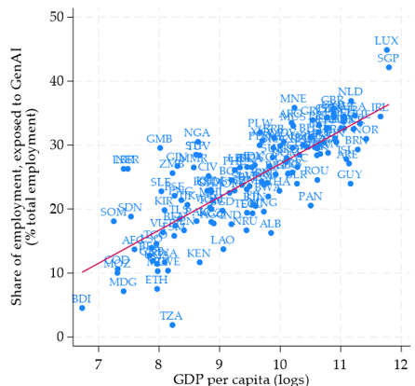
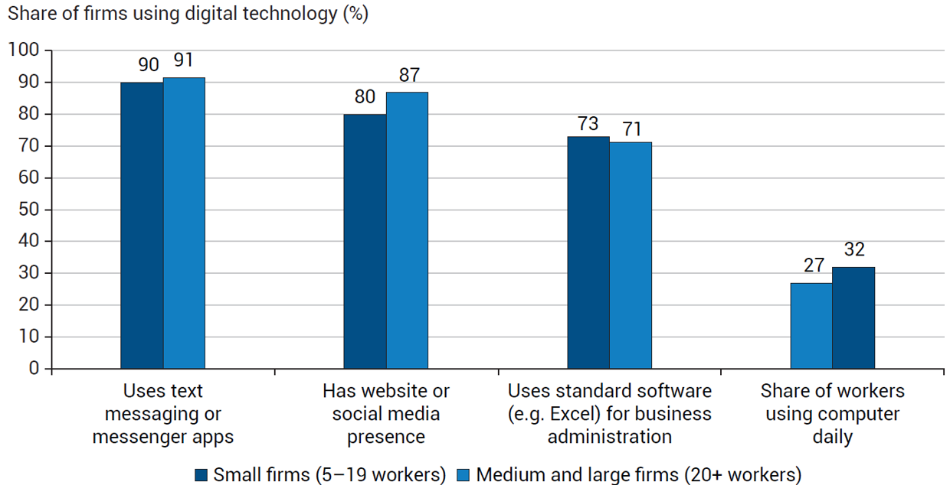
For developing economies, the risk of job disruption is less imminent but the potential for small businesses is big and immediate
The share of jobs amenable to AI use is lower in developing countries than in advanced economies
Many businesses in developing countries already use digital technologies that facilitate the adoption of AI solutions
Sources: WDR 2026 team based on Gmyrek et al. 2026, ILOSTAT, and World Development Indicators
Source: WDR 2026 team based on World Bank Enterprise Survey on AI Adoption data.

Slide 11
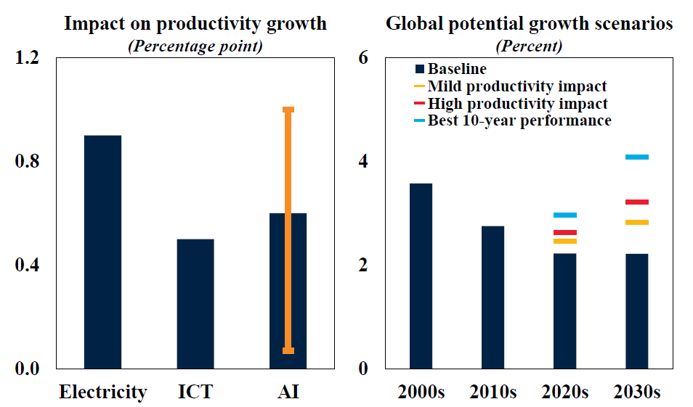
AI’s potential impact on global productivity growth is sizeable
Source: Global Economic Prospects, June 2026

Slide 12
AI could do in a decade what might otherwise have taken a century
Agriculture: In India’s state of Telangana, AI-generated weather forecasts have improved cropping, investment and production choices
Legal: In Kenya, the judiciary has used a predictive AI algorithm to allocate 10,000 court cases per year among ~1,500 mediators to successfully reduce the backlog
Medical care: In Bangladesh, AI-generated medical imaging has increased the number of patients screened for a complication of diabetes by 40 percent per day

Slide 13
AI strategies in developing economies
WDR 2026: Adaptation will have to be the mainstay of AI strategies
  Context-specificity means that adoption by itself won’t be enough
  Time is of the essence, so advancement is generally not a cost-conscious option
Governments should be avid users of AI in public service provision
  Healthcare, judicial and legal services, agricultural extension and education
  Predictive AI in back-end use is more promising than generative AI on the frontlines
Private sector use of AI should build in inter-operability
  AI sovereignty is out of reach for most countries
  Governments should enable industry-led voluntary standards, not rely mainly on mandates

Slide 14
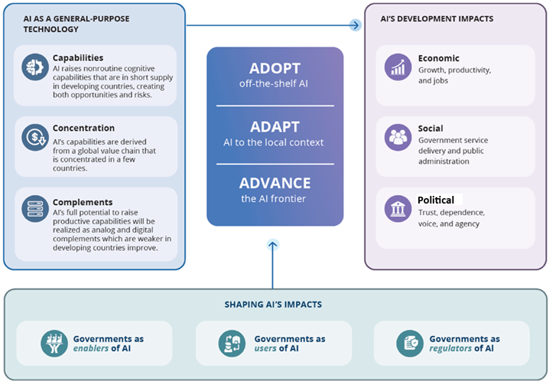
WDR 2026 Framework
Source: WDR 2026 team

Slide 15
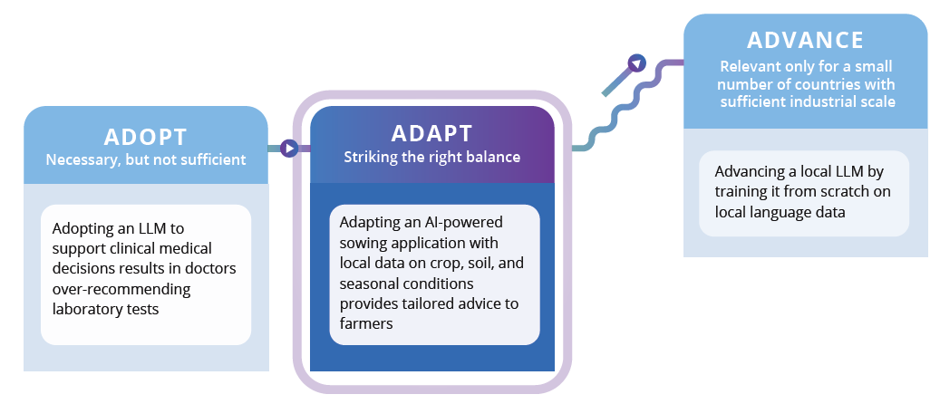
1. Adaptation is the mainstay of an effective AI strategy in EMDEs
Source: WDR 2026 team

Slide 16
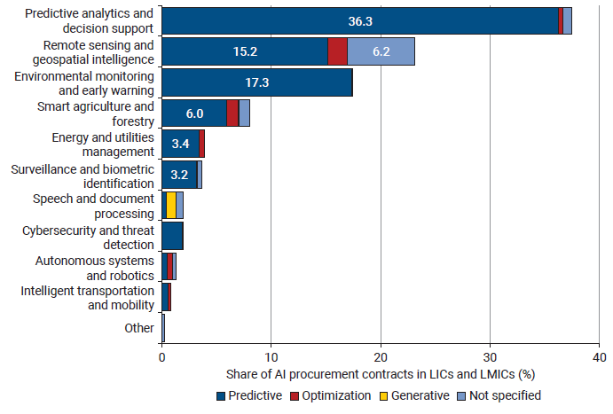
2. The hype is about generative AI for front-line service delivery, but the big gains are from predictive AI at the back-end of public administration
Back-end AI adoption in developing countries provide predictive analytics and decision support, geospatial intelligence, and early warning systems, and overwhelmingly use predictive AI
Large-language models in
front-line health care provision are not quite there yet
“In a study in Nigeria, the LLM did not reliably identify missed diagnoses. Health workers judged the feedback from the LLM to be helpful but were not effective at distinguishing good from bad advice”
Source: WDR 2026 team analysis of procurement contracts.

Slide 17
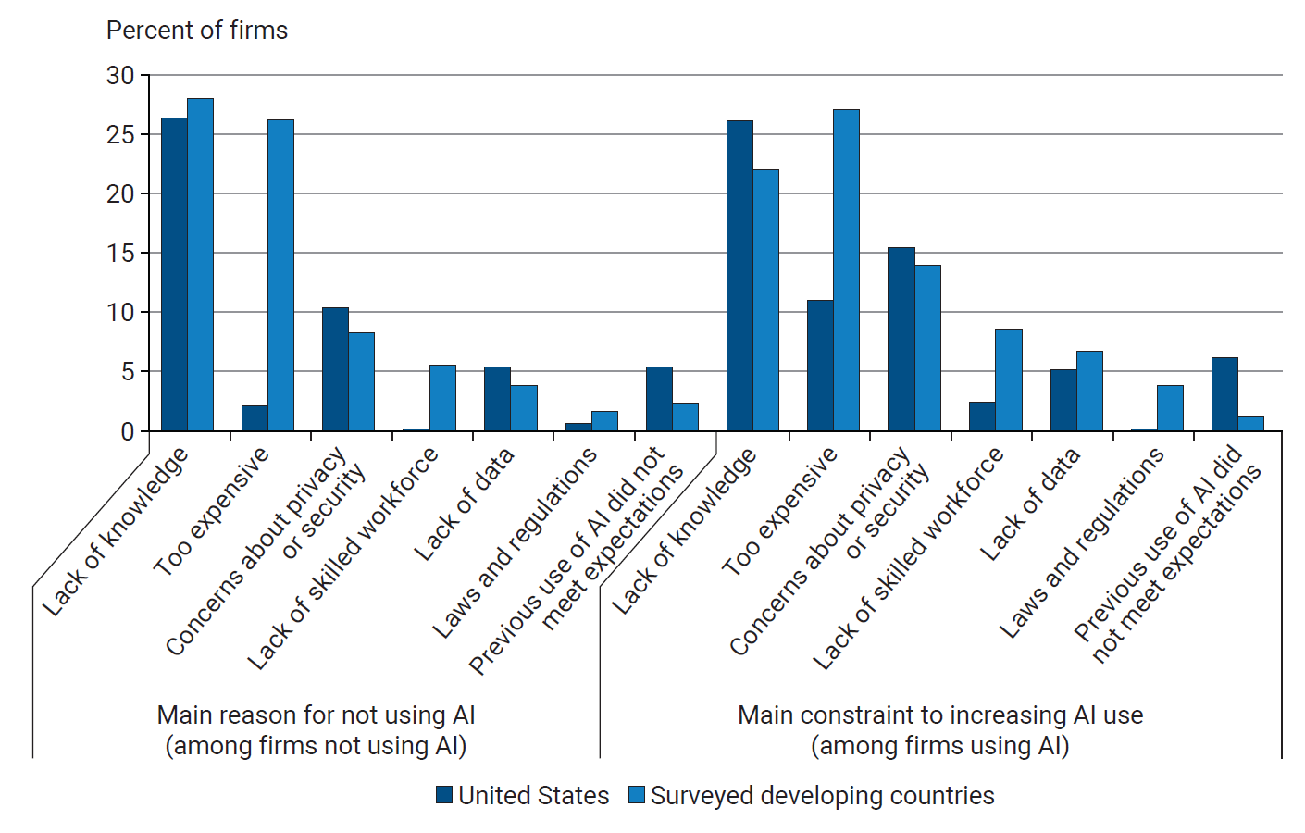
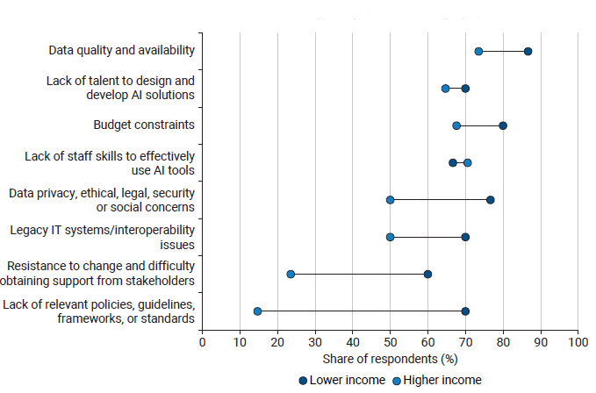
3. Like previous GPTs, the digital infrastructure matters but the analog complements matter even more
Businesses highlight the lack of information as an important reason for not adopting or scaling up AI solutions
Major or moderate obstacle for the government’s internal use of AI tools
(in percent)
Sources: WDR 2026 team based on World Bank Enterprise Survey on AI Adoption data.
Source: WDR 2026 team based on the World Bank AI and Data for Better Governance Survey.

Slide 18
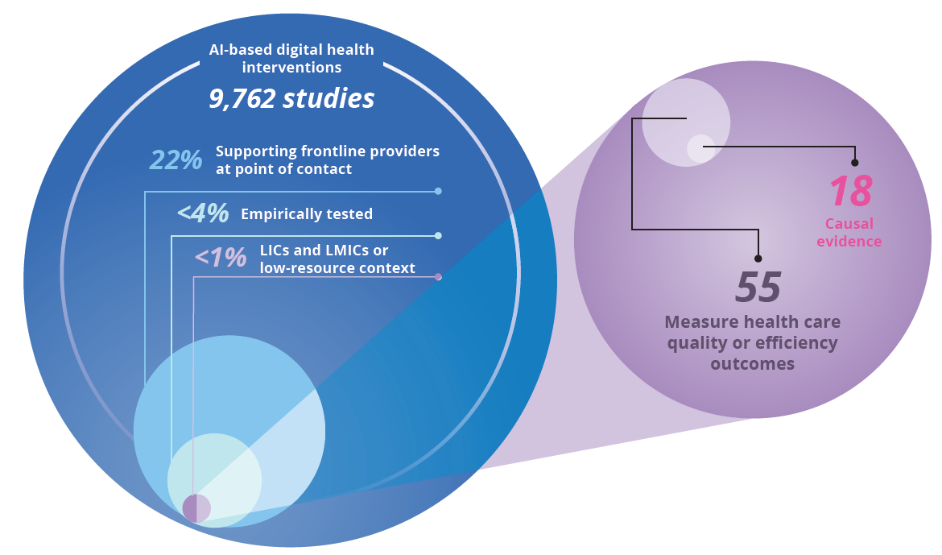
4. Little reliable information exists on what works in poor countries;
EMDEs need frameworks to procure, pilot and scale AI technologies
Among thousands of published articles on AI in health care, less than 0.2 percent provide causal evidence of impact in low-resource settings
Source: WDR 2026 team based on Sautmann and Weinert 2026.

Slide 19
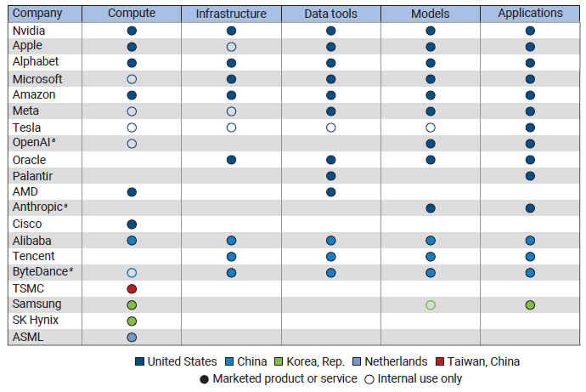
5. EMDEs should deal with dependency risks with interoperable models, rather than aiming for AI sovereignty
Leading AI-related companies mainly in China and the United States
The quest for AI sovereignty is expensive and can lead to fragmentation
Open models and interoperability across different layers of the AI stack can provide big benefits
Sources: Frost et al. 2026 based on PitchBook.

Slide 20
6. EMDEs should not obsess with mandatory standards for AI; instead enable industry to adopt voluntary standards
“In Bangladesh, algorithmic predictions based on cell phone data performed worse than traditional methods to identify poor households to improve the targeting of cash transfers”
More than 800 voluntary standards have been published or are under development, to coalesce around tools—impact assessments, audit frameworks, and testing protocols—that guide responsible AI use
“The performance of an AI application developed in the United Kingdom to triage patients suspected of having COVID-19 declined sharply in Viet Nam because patient demographics were so different”
Generative AI has been used to “sow doubt, smear opponents, or influence public debate” across countries through fake images, videos, and text

Slide 21
World Bank Group AI strategy: Small AI in a suitcase
The WBG’s AI approach is dual track: deliver immediate development impact through locally relevant Small AI, while building the compute, data, skills, and trust foundations needed for responsible AI at scale.
Scale “Small AI”
Prioritize use cases that work on everyday devices, edge servers, SMS, voice, intermittent or no connectivity.
Deploy Small AI use cases across flagship programs and crisis-response efforts.
Build replication-ready blueprints for proven open-source AI solutions.
Invest in country capacity
Establish AI and Digital Trust Academies for government officials, regulators, and sector ministries.
Strengthen public-sector ability to make AI policy, procurement, and investment decisions.
Support local AI entrepreneurs through pilots such as “Small AI in a Suitcase”
Invest in long-term AI foundations
Assess and expand fit-for-purpose AI compute options: cloud, edge, shared infrastructure, or national compute
Strengthen AI-ready data systems, including public data governance, data catalogs, sandboxes, and secure data-sharing mechanisms.
Promote responsible AI through cybersecurity, data protection, and risk-based governance frameworks.
Notes:
Bring edge computing to rural and underserved communities: The WBG will pilot Small AI in a Suitcase as a mechanism to facilitate access for local AI entrepreneurs to compute and technical training to enable private sector-led adaptation and deployment of Small AI solutions in low‑resource settings. This approach will focus on advancing practical locally adapted AI solutions in sectors such as education, health, and agriculture. This approach will also – where feasible – support FCV settings and small states to advance crisis response, such as early‑warning systems, damage assessment, crisis mapping, and displacement monitoring, using tools that work with limited or no internet connectivity. These deployments will help countries better understand local demand for computing power and data to inform future investments. This pilot is being developed with private technology partners, such as Nvidia to support bringing edge compute capabilities to countries, and academic institutions and will be rolled out in 10 countries across regions, starting with Africa.

Slide 22
AI use in World Bank Group operations
Education – Nigeria: A WBG-supported pilot program showed that AI chatbot tutors can help gain nearly two years of learning in grammar and writing skills in just six weeks for secondary students.
Food Security: The ZeroHungerAI initiative uses machine learning to analyze weather, market prices, and satellite imagery to predict food insecurity and identify hunger hotspots early.
Education – Peru: AI-powered math tutoring and career guidance tools deployed in 100 public schools in Lima through the "Eligiendo Mi Camino" program.
Health – Nigeria: AI-powered portable ultrasound devices are being explored to help frontline health workers with maternal and fetal assessments in low-resource communities.
Agriculture – India: The UP PRAGATI Accelerator, a technical assistance program launched in 2022, has supported nearly 300,000 farmers adopt precision irrigation. The program has expanded rice cultivation by 400%, benefiting 200,000 farmers.
Crisis Management – Uganda: WBG has developed an AI model analyzing over 90 variables to forecast refugee arrivals 4–6 months in advance to enable better preparedness.

Slide 23
Summary
AI impacts are not the same as in advanced economies
    Developing countries should be optimistic and aggressive
  2. AI technologies are even more context-specific than previous GPTs
    Neither simple adoption nor advancement strategies are feasible for most countries
    Adaptation will have to be the main part of the strategy in developing countries
  3. AI strategies in developing countries require making choices
    Enable smaller diffused investments in the private sector
    Emphasize predictive AI back-end use in public service provision
    Encourage industry-led voluntary standards

