Slide 1




Central Bank of Nigeria
7th Africa Emerging Markets Forum
Navigating Global Shocks: Monetary Policy Challenges for African Central Banks
July 29, 2026

Slide 2

Presentation Outline
01
Introduction
02
Literature Review
03
Methodology
04
Results
05
Key Findings
06
Policy Implications & Recommendations
07
Conclusion

Slide 3

1.0 | Introduction – A More Uncertain World
Since 2020, several shocks have disrupted global supply chains, fueled commodity price volatility, and heightened external uncertainty particularly for African economies.
2020
COVID-19
2022
Russia-Ukraine War
2023 – 2025
Middle East Crisis
Supply chains collapse;
demand shock
Food & energy
prices spike
Crude Oil Price Shock.

Slide 4
1.0 | Introduction – Research Questions & Objectives
Research Objectives
1
Analyse the significant transmission mechanisms through which global shocks affect monetary policy outcomes in African economies.
2
Evaluate the effectiveness of monetary policy responses adopted by selected African central banks during major global shock episodes.
Research Questions
1
Through which channels do global shocks affect monetary policy outcomes in African economies?
2
How effective have African central banks been responding to recent global shocks?
3
What lessons can be drawn for strengthening monetary policy resilience?

Slide 5
2.0 | Literature Review – Theoretical Foundations
African economies remain highly vulnerable to external shocks due to shallow financial markets, foreign-currency exposures, and exchange rate pass-through (El-Said & Takebe, 2016; Balcilar et al., 2019).
Mundell–Fleming Trilemma
Quadrilemma
Countries cannot simultaneously maintain free capital mobility, a fixed exchange rate, and independent monetary policy (Obstfeld et al., 2005).
Financial stability emerged as a fourth objective, intensifying policy trade-offs among monetary independence, exchange rate stability, and capital mobility (Obstfeld, 2021).
1
2
3
4
Rey's Dilemma
Policy Credibility
Global financial integration constrains open-capital-account countries regardless of exchange rate arrangements; the trilemma collapses to a dilemma (Rey, 2018).
Credible central banks anchor inflation expectations, while weak credibility fuels inflation persistence and weakens policy effectiveness (Kydland & Prescott, 1977).

Slide 6

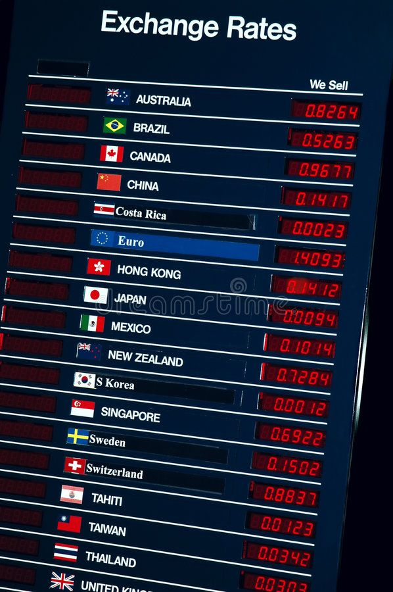


2.0 | Literature Review – Theoretical Foundations…
The Quadrilemma
Monetary Independence
Exchange-Rate
Stability
Capital
Mobility
Financial
Stability
For Africa: shallow markets and FX exposure make all four objectives, binding simultaneously

Slide 7
2.0 | Literature Review – Monetary Policy Frameworks
Global Monetary & Financial Cycles
Commodity Price Shocks
Health & Supply Chain Shocks
US monetary tightening induces capital flow reversals and widens sovereign spreads. Countries with lower credibility and larger FX liabilities face stronger adverse spillovers (Kalemli-Özcan & Unsal, 2023).
Oil-exporting Countries benefit from favourable prices through export revenues but faces inflationary pressures via energy costs. Others are exposed through broader mineral and metals channels (Kilian, 2009).
COVID-19 demonstrated that health crises rapidly evolve into macroeconomic shocks. Supply-chain disruptions generated significant, persistent effects on headline and food inflation across Sub-Saharan Africa (Andriantomanga et al., 2023).
Geopolitical Risk Shocks
Exchange Rate Pass-Through
Repercussions of Russia–Ukraine, and Middle East conflicts transmit through commodity markets, investment flows, and global risk sentiment. Such shocks involve simultaneous supply and demand effects (Caldara & Iacoviello, 2022).
Pass-through is relatively complete and persistent in Nigeria but limited in South Africa. Strong pass-through means exchange rate depreciation rapidly translates into domestic inflationary pressures, complicating policy responses (Balcilar et al., 2019).

Slide 8


3.0 | Methodology – Data – Nigeria vs South Africa
Nigeria and South Africa account for more than ~50% of Sub-Saharan African GDP
 | Framework | Exchange Rate | Financial Depth | Shock Exposure
Hybrid monetary targeting
(currently on transition to Inflation Targeting)
Managed float (unified June 2023)
Moderate (<15% of GDP credit)
Oil prices, food imports, USD
vs
Formal inflation targeting (2000)
Freely
floating
rand
Deep
(80–90% of GDP credit)
Global risk and commodity price shocks
Note: Domestic data are sourced primarily from the IMF International Financial Statistics (IFS) database and cross-checked with national central bank publications and the World Bank's World Development Indicators (WDI).

Slide 9

3.0 | Methodology – Identifying Global Shocks
A central challenge is isolating global shocks that are exogenous to the African economies under examination.
Five shock proxies are employed, each with a distinct identification approach.
Shock Type
Proxy / Instrument
Identification Approach
Source
US Monetary Policy
Wu-Xia shadow federal funds rate (to Jul 2023); EFFR thereafter
Exogenous by small-country assumption; weak exogeneity tested in GVAR
Wu & Xia (2016); FRED
Euro Area Monetary Policy
Krippner shadow rate
Exogenous by small-country assumption
Krippner (2015); RBNZ
Structural residual from 3-variable global oil VAR
Kilian (2009) recursive Cholesky decomposition
EIA; Kilian IGREA; Brent (FRED)
Oil Supply Shock
Food Price Shock
FAO Food Price Index log first
difference
Net food-importing assumption; proxy-based
FAO
Global Risk / VIX
VIX log change
Exogenous to small open economies
CBOE VIX via FRED
All shock series are standardised to unit variance for cross-shock comparability in local projection regressions.

Slide 10

3.0 | Methodology – GVAR Framework
Country-Specific VARX* Models
Impulse Responses & Variance Decompositions
For each economy, a country-specific VAR is estimated with domestic endogenous variables: CPI inflation (π), log change in bilateral exchange rate (Δe), central bank policy rate (r), and log change in international reserves (Δres). Global exogenous variables include Brent oil price, FAO Food Price Index, VIX, and advanced-economy shadow rates.
Dynamic responses are computed as Generalised Impulse Response Functions (GIRFs) following Pesaran and Shin (1998) — order-independent by construction. Bootstrap confidence intervals use 2,000 residual resampling draws at 68% and 90% levels.
Trade Weights
System Stability
Computed from average bilateral merchandise trade flows over a rolling three-year window using IMF DOTS data, capturing China's growing importance for both economies over the 26-year sample.
Verified by confirming all eigenvalues of the global companion matrix lie strictly inside the unit circle. Maximum modulus eigenvalue = 0.950 under latest trade weights — the system is dynamically stable.
Weak exogeneity is not uniformly satisfied, especially for South Africa's global financial variables. GVAR responses are interpreted as conditional dynamic patterns, not fully structural causal estimates.

Slide 11
3.0 | Methodology – Local Projection (LP) Techniques
The LP panel uses country fixed effects only. Full time fixed effects are excluded to avoid collinearity with common global shock series.
Baseline
Local Projections
Driscoll-Kraay standard errors are used for pooled two-country estimates.
Interaction
Local Projections
Newey-West for country-specific regressions.
Taylor
Residuals
A quarterly robustness specification incorporates real GDP growth and net portfolio capital flows as additional controls and outcomes.

Slide 12
3.0 | Methodology – Empirical Model
GVAR / VARX*
Local Projections
Transmission of global shocks
Policy effectiveness at each horizon
xᵢ,ₜ = aᵢ + ΣΦᵢ xᵢ,ₜ₋ₗ + ΣΛᵢ x*ᵢ,ₜ₋ₗ + Γᵢ gₜ + εᵢ,ₜ
yᵢ,ₜ₊ₕ = αʰ + βʰShockₜ + δʰ(Shockₜ × Policyᵢ,ₜ) + ΩʰXᵢ,ₜ + uᵢ,ₜ₊ₕ
βʰ
Direct shock effect at horizon h
xᵢ,ₜ
Inflation · Exchange Rate · Policy Rate · Reserves
δʰ
Interaction: does tightening dampen pass-through?
x*ᵢ,ₜ
Trade-Weighted Foreign Variables
δʰ<0
Tightening dampens shock pass-through
gₜ
US Monetary Policy · Oil · Food Prices · VIX
δʰ≈0
No significant dampening effect detected
GVAR traces transmission · LP tests whether policy dampens pass-through

Slide 13
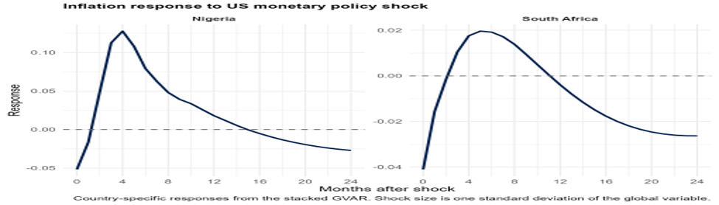
4.0 | Results: GVAR Evidence
This suggests that the inflationary effect of US monetary tightening is not persistent in either economy, although the short-run adjustment is stronger in Nigeria.
Key Findings
Inflation Response to US Monetary Policy Shock
US Monetary Policy shock generates different inflationary responses in South Africa and Nigeria.
In Nigeria:
Inflation falls at first.
Rises sharply in the first few months.
Gradually declines, turning negative in the medium term.
In South Africa:
Inflation also declines at impact.
Rises moderately in the early months.
Turns negative after about one year.
This suggests that the inflationary effect of US monetary tightening is not persistent in either economy, although the short-run adjustment is stronger in Nigeria.

Slide 14
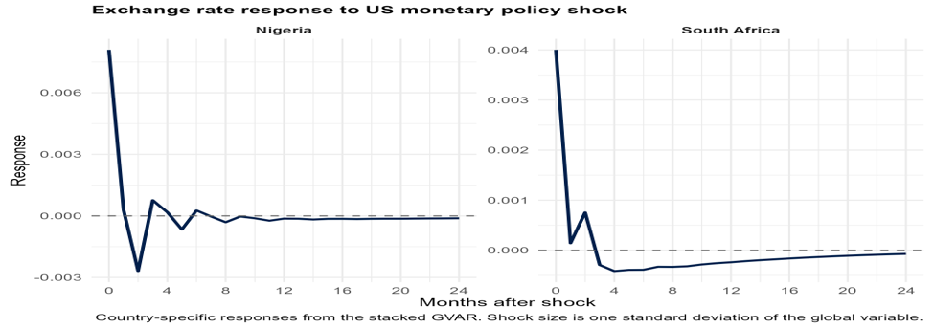
4.0 | Results: GVAR Evidence
Key Findings
Exchange Rate Response to US Monetary Policy Shock
The exchange-rate response to US monetary tightening is short-lived in the GVAR.
In Nigeria:
Records a larger immediate depreciation in the exchange rate following US monetary tightening.
Quickly corrects, making the effect short‑lived.
In South Africa:
Shows a smaller initial exchange‑rate response.
Adjustment fades gradually over time.
Local projection estimates reveal stronger evidence of exchange‑rate sensitivity to US monetary policy shocks.
South Africa shows stronger evidence of exchange-rate sensitivity to US monetary policy shocks compared to Nigeria.

Slide 15
4.0 | Results: Forecast Error Variance Decomposition
 | 12-month main drivers |  | 12-month main drivers
NG – Inflation | Own shock 71.37%; exchange rate 12.61%; MPR 3.65%; reserves 5.74% | SA – Inflation | Own shock 76.61%; MPR 17.42%
NG – Exchange Rate | Own shock 77.97%; MPR 14.28%; Inflation 3.06% | SA – Exchange Rate | Own shock 89.88%; MPR 4.41%
NG – Policy Rate | Own shock 63.67%; inflation 18.15%; exchange rate 16.50% | SA – Policy Rate | Own shock 76.07%; inflation 13.94%
 | 24-month main drivers |  | 24-month main drivers
NG – Inflation | Own shock 57.88%; exchange rate 9.79%; MPR 13.62% | SA – Inflation | Own shock 77.35%; MPR 15.89%
NG – Exchange Rate | Own shock 77.36%; MPR 14.68% | SA – Exchange Rate | Own shock 89.35%; MPR 4.59%
NG – Policy Rate | Own shock 48.46%; inflation 30.32%; exchange rate 16.74% | SA – Policy Rate | Own shock 68.36%; inflation 19.60%
So, what does this mean?
Nigeria exhibits greater inflation persistence, with inflation‑specific shocks explaining about 71% at 12 months and 58% at 24 months of inflation variance.
South Africa demonstrates stronger monetary policy transmission, with policy shocks accounting for roughly 17% of inflation variance, compared with 3–14% in Nigeria.
The CBN’s policy response to inflation strengthens over time, while the SARB maintains a more stable reaction function, with own shocks
consistently explaining around 77% of inflation variance.

Slide 16
4.0 | Results: Local Projection Results
Pooled Baseline LP (Monthly)
Country-Specific LP Highlights
US monetary policy → inflation: Negative across horizons but statistically insignificant — weak direct pass-through.
Kilian oil supply → inflation: Negative and weakly significant at 6 months — delayed pass-through.
Nigeria — US monetary policy: No strong inflation or exchange-rate response; official FX series understates adjustment during dual-rate period.
South Africa — US monetary policy → inflation: Insignificant across horizons despite clear exchange-rate channel.
Food price → exchange rate: Significant from impact through 6 months — strongest pooled result.
VIX → exchange rate: Positive and significant only at impact — short-lived risk channel.
Nigeria — food price → exchange rate: Negative and significant at 3, 6, and 12 months — Nigeria's strongest result.
South Africa — US monetary policy → exchange rate: Positive and significant from impact through 12 months — South Africa's strongest result.

Slide 17
5.0 | Key Empirical Findings
01
02
03
Structural differences matter
Exchange‑rate channel dominates
in both economies
Food price shocks are persistent
Inflation inertia (own shocks) contribute significantly to Nigeria’s inflation, while South Africa’s inflation reflects stronger monetary policy influence due to its inflation‑targeting framework.
Food price shocks generate a robust and persistent exchange rate effects, significant in both monthly and quarterly specifications due to structural issues such as insecurity, infrastructure, imported inflation and climate-related issues.
Exchange rate channel is important in South Africa. Also, Nigeria’s unified floating exchange‑rate regime has reactivated the exchange‑rate channel, making US monetary policy shocks transmit more transparently into domestic prices.
04
05
Domestic monetary multipliers diverge
Partial insulation from global shocks
South Africa’s monetary tightening produces delayed but clear disinflation, while Nigeria’s transmission is less predictable, reflecting differences in policy credibility and frameworks.
Domestic policy dampens some global spillovers, especially risk shocks, but struggles to consistently reduce inflation pass‑through from US monetary shocks.

Slide 18
6.0 | Policy Implications & Recommendations
Implication 1:
Expand Monetary Surveillance
Implication 2:
Exchange Rate Is Central, Not Secondary
Treat global financial conditions as core monetary policy inputs, not external noise.
Exchange-rate pressures are not symptoms — they are the primary transmission channel.
Implication 3:
Rate Policy Needs Structural Support
Implication 4:
Framework Choice Is Not Enough
Structural reforms are complements to — not substitutes for — interest-rate tools.
What matters is whether the economy has the transmission capacity to make the framework work.

Slide 19
7.0 | Conclusion
Using a two-country stacked GVAR complemented by panel local projections from 2000–2025, this study identifies how structural characteristics moderate or amplify global shock transmission, extending single-country evidence (Tumala et al., 2021) and undifferentiated panel evidence (Beirne & Renzhi, 2024).
For Both Central Banks
For the CBN (Nigeria)
For the SARB (South Africa)
Exchange rate remains the primary conduit of global shock transmission, not a secondary symptom. Surveillance frameworks and communication strategies must treat exchange-rate pressure from global food and financial shocks as a core monetary policy input.
The June 2023 FX unification is a prerequisite for a credible monetary transmission. The multiple rate regime did not prevent global shocks from affecting the economy, it rendered adjustment opaque.
Evidence of delayed but statistically meaningful disinflationary effects from tightening is consistent with the inflation-targeting mandate. However, Kabundi and Rapapali (2019) caution that the interest-rate channel can weaken during prolonged low-growth environments.

Slide 20

THANK YOU
FOR YOUR ATTENTION

