Slide 1
EMERGING MARKETS FORUM – CBN CONFERENCE PAPER
Foreign Direct Investment,
Technology Transfer,
and Inclusive Growth
in Sub-Saharan Africa
Evidence, Lessons from East Asia, and Policy Priorities
Menachem Katz
CBN–Emerging Markets Forum Conference · Abuja · July 2026
Notes:
CONDENSED 10-MINUTE VERSION — 9 slides, ~65-70 sec each. Welcome. This paper asks: why has FDI driven structural transformation in East Asia but not in Sub-Saharan Africa? With Nigeria as the central case study, we use panel regressions across 28 SSA economies and 52 non-SSA economies to show that FDI's impact is deeply conditional on institutional quality, macro stability, and absorptive capacity. Target: ~1 min.

Slide 2
INTRODUCTION
Three Questions This Paper Answers
Q1
Under what conditions does FDI raise growth in emerging and developing economies?
Paper Roadmap
§2
Motivation & stylized facts
Q2
Through which channels does FDI generate employment and technology transfer?
§3
Literature & absorptive capacity
§4
Conceptual framework
Q3
What policy packages can increase the inclusiveness of FDI-led growth in Africa?
§5–6
Data, strategy & empirical results
§7
East Asia lessons & Nigeria
§8–9
Policy agenda & conclusion
Motivated by SSA's persistent shortfall in productive job creation and structural transformation
Section 1 · Introduction
EMF–CBN Conference · Abuja · July 2026
2
Notes:
Target: ~0:40. Three explicit questions from Section 1. Q3 is highlighted — policy packages — as the culmination. Build from Q1 (conditions) → Q2 (channels) → Q3 (what to do). Roadmap maps sections to questions.

Slide 3
EXECUTIVE SUMMARY
Six Key Findings
1
FDI is not automatically development-enhancing. Growth, jobs, and technology transfer depend on host-country absorptive capacity and predictable institutions.
2
Spillovers are strongest through linkages. Backward linkages to domestic suppliers and worker mobility are more reliable than horizontal spillovers.
3
Sector composition matters for inclusion. Resource-seeking FDI is capital-intensive with weak linkages; export-oriented manufacturing generates larger employment multipliers.
4
Macroeconomic stability is a prerequisite. Nigeria's deficit averaged ~4.9% of GDP over 2015–25 vs. 2.4% (Indonesia), 3.6% (Vietnam), 3.7% (Malaysia). Credibility is the first-order reform.
5
Policy priorities are actionable and measurable. Focus: (i) macro stability, (ii) trade facilitation, (iii) skills & capabilities, (iv) supplier development, (v) SEZ governance.
6
Evaluate by outcomes, not inputs. Track supplier contracts, training hours, domestic value-added, worker progression, and export performance.
Executive Summary
EMF–CBN Conference · Abuja · July 2026
3
Notes:
Target: ~1:00. Six bullets from the Executive Summary. Bullet 4 (macro stability) is highlighted green — the organizing argument. Note: the three new comparative regression sections (6.3, 6.4) add cross-regional validation of the conditionality result.

Slide 4
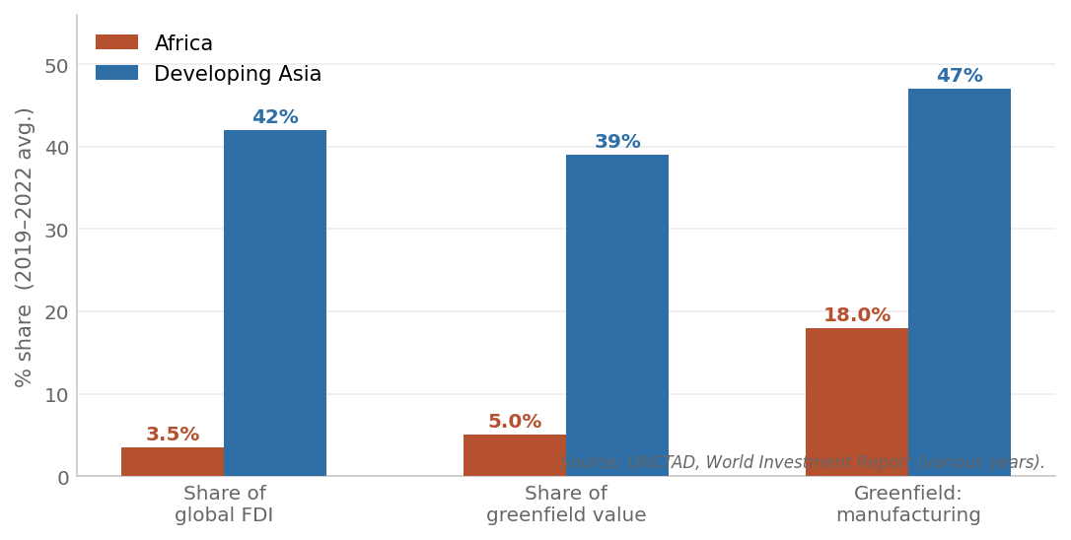
01 · MOTIVATION
Figure 1. Africa vs. Developing Asia: A Persistent FDI Gap
Table 1 Highlights
3.5% vs 42%
Africa vs Asia share of global FDI inflows
5% vs 39%
Greenfield project value gap
18% vs 47%
Manufacturing greenfield — highest-spillover category
Low/rising
Africa's intraregional FDI — still limited
Note: 2019–2022 averages. Source: UNCTAD, World Investment Report (various years).
The manufacturing greenfield gap (18% vs 47%) is the most policy-relevant: this is where technology spillovers concentrate.
Figure 1 / Table 1 · Section 2 · Stylized Facts
EMF–CBN Conference · Abuja · July 2026
4
Notes:
Target: ~1:00. The gap is stark across all three UNCTAD FDI indicators, but the manufacturing greenfield share (18% vs 47%) is the most important: this is where spillovers, backward linkages, and job creation are concentrated. Africa's challenge is not just volume but composition.

Slide 5
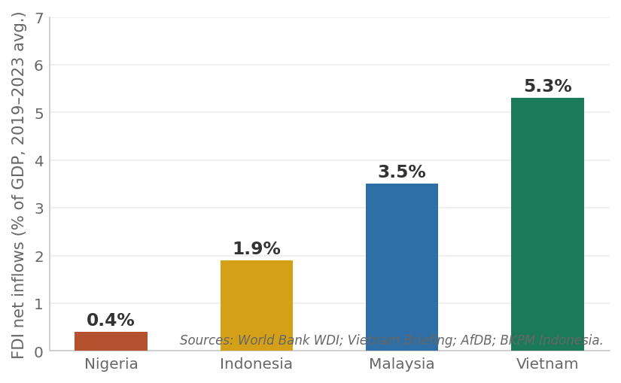
02 · MACRO STORY
Figure 6 & Table 2. The Aggregate Result: Instability Begets Low, Enclave FDI
Nigeria
Vietnam
Malaysia
Indonesia
Avg. CPI inflation (2015–24)
~17%
3.2%
2.4%
3.8%
FX depreciation (2015–24)
>630%
~8%
~30%
~35%
Avg. fiscal deficit (2015–25)
~4.9%
~3.6%
~3.7%
~2.4%
WGI Rule of Law (pctile)
~14th
~46th
~62nd
~45th
Avg. FDI net inflows, % GDP (2019–23)
~0.4%
~5–6%
~3.5%
~1.9%
FDI composition
Extractives
Mfg 70%+
Mfg/svc
Mfg/res
Systemic pattern: Fiscal imbalance → monetary expansion → inflation → FX pressure → FDI deterrence → slower growth → constrained revenues → back to fiscal imbalance. Nigeria attracted FDI averaging only ~0.4% of GDP over 2019–23 — a 12-fold gap versus Vietnam's 5–6%. The 2024 FPI surge ($13bn, +110%) is yield-seeking portfolio capital — the opposite of technology-bundled FDI.
Sources: IMF WEO (April 2026); IMF Nigeria Article IV (2025); World Bank WDI/WGI; AfDB; Strategy& Nigeria Outlook 2026.
Figure 6 / Table 2 · Section 2.1.6 · FDI Outcomes
EMF–CBN Conference · Abuja · July 2026
5
Notes:
Target: ~1:15. The six macro deficiencies compound each other in a self-reinforcing cycle. Nigeria averaged FDI of only ~0.4% of GDP over 2019–23 — the paper uses this average, not the 2024 single-year figure. Compare with Vietnam at 5–6% of GDP and Indonesia at ~1.9%. The 2024 FPI surge was short-term yield-seeking capital, not technology-bundled FDI.

Slide 6
04 · EMPIRICS · PREVIEW
Before the Tables: Three Numbers That Matter
≈0 (n.s.)
0.283***
0.247–0.261***
Unconditional FDI effect — negligible across every specification, SSA and beyond
FDI × Rule of Law, SSA panel (28 countries) — the growth payoff from FDI is conditional
Non-SSA and pooled estimates — nearly identical to SSA: the mechanism is universal
Nigeria sits left of the zero-crossing threshold (Rule of Law ≈ −0.7 WGI) where FDI's marginal effect turns positive — its FDI challenge is not just a shortage of investment, but institutions too weak to convert it into growth. A one s.d. in the ROL raises the marginal growth effect of FDI by about 0.15 % points per p point of FDI-to-GDP.
In the paper: Full panel specifications, cross-regional validation, and robustness tests are detailed in the paper (Sections 6.1–6.4).
Section 6 Preview · Empirical Highlights
EMF–CBN Conference · Abuja · July 2026
6
Notes:
Target: ~1:30 -- this is the core slide of the condensed talk; slow down here. Lead with the plain-language finding before the numbers: FDI alone doesn't move growth, but FDI paired with strong institutions does. State each of the three cards, then land on the Nigeria zero-crossing point as the bridge into "what to do about it" (Vietnam and the policy pillars).

Slide 7

05 · EAST ASIA
Vietnam: The Most Instructive Parallel for SSA
Doi Moi (1986) → WTO Accession (2007)
Five Operational Lessons
1. Macro stability
✦ Started from a low-income, agrarian base — much like SSA today
Single-digit inflation, predictable FX, no crowding-out fiscal deficits
✦ Dismantled FDI barriers while maintaining macroeconomic discipline
2. Relax binding constraints
Power, logistics, and trade facilitation before everything else
✦ Used SEZs and industrial parks to concentrate FDI in export manufacturing
3. Capability building
STEM education, TVET, managerial upgrading aligned with FDI demand
✦ By 2024: manufacturing/processing >70% of FDI; electronics = $72.6bn in exports
4. Export orientation
Integration into regional and global markets for scale and learning
✦ Avg. inflation <4%; transparent managed FX; fiscal deficit ~3.6% GDP
5. Linkage institutions
Supplier development, standards, logistics — upgrade over time
Indonesia also instructive: statutory 3% deficit ceiling + independent central bank → manufacturing-oriented FDI despite governance challenges.
Section 7.1 · East Asia's FDI-Intensive Industrialization
EMF–CBN Conference · Abuja · July 2026
7
Notes:
Target: ~1:15. Vietnam started from conditions close to SSA today and achieved a dramatic transformation through macro discipline + SEZ strategy + capability building. Indonesia shows that even a large resource-rich economy with governance challenges can attract manufacturing FDI with fiscal credibility.

Slide 8



06 · POLICY AGENDA
Table 6. Three Mutually Reinforcing Pillars
1. Credibility
& Predictability
2. Tradables
Competitiveness
3. Capabilities
& Linkages
REFORM EXAMPLES
REFORM EXAMPLES
REFORM EXAMPLES
Medium-term tax/tariff roadmaps; rules-based regulatory change; digital licensing with published timelines.
End-to-end digital customs; reliable power for industrial corridors; competition in ports/logistics.
Demand-driven TVET tied to anchor investors; co-financed SME certification; supplier development centers.
KEY METRICS
KEY METRICS
KEY METRICS
Permit processing time (P50/P90 days); policy stability index; investor retention rate.
Customs release time (P50/P90 hours); power outage hours; zone occupancy; time-to-production.
Supplier contracts (count/value); local procurement share; training hours; domestic value added.
Table 6 · Section 8 · Policy Implications
EMF–CBN Conference · Abuja · July 2026
8
Notes:
Target: ~1:15. Three mutually reinforcing pillars from Table 6. Each includes concrete reform examples and measurable outcome metrics — deliberately avoiding vague aspirational language. Track supplier contracts, training hours, domestic value added, and export performance rather than just investment commitments.

Slide 9
CONCLUSION
FDI Is a Catalyst — Not an Automatic Engine
0.283***
0.261***
4.9% vs 2.4%
FDI's growth effect is conditional on Rule of Law — SSA panel (28 countries)
Pooled cross-regional estimate — conditionality does not differ SSA vs non-SSA
Nigeria avg. fiscal deficit vs Indonesia, 2015–25 — roughly double
Restoring macroeconomic credibility — fiscal consolidation toward 3–3.5% of GDP, transparent FX management, and independent monetary institutions — is the first-order structural reform. The conditionality result 0.283*** means every unit of institutional improvement amplifies FDI's growth impact directly.
Prioritize: macro stability · linkage-building over horizontal spillovers · outcome-based SEZ evaluation · capabilities & supplier development
Section 9 · Conclusion
EMF–CBN Conference · Abuja · July 2026
9
Notes:
Target: ~1:00. Close with three numbers: 0.283*** (SSA conditionality), 0.261*** (pooled — universal mechanism), 4.9% vs 2.4% (Nigeria's fiscal gap vs Indonesia). The universal conditionality result is the strongest finding: it means SSA's FDI challenge is not a structural peculiarity but a consequence of institutional quality lying left of the zero-crossing on the conditional effect curve. Fix the institutions, fix the FDI problem.

Slide 10
Thank You
Discussion & Questions
Menachem Katz
Foreign Direct Investment, Technology Transfer,
and Inclusive Growth in Sub-Saharan Africa
EMF–CBN Conference · Abuja · July 2026
Notes:
Target: ~0:15. Anticipated questions: (1) data quality/NBS CPI rebase — all SSA and non-SSA regressions use WDI data; (2) weak IV in SSA — retained for transparency, main results stand on FE specification; (3) Nigeria-specific feasibility of SEZ reforms given federal structure and security challenges — the paper's framework is about design conditions, not wholesale copying; (4) endogeneity of institutional quality itself — the triple interaction test in Table 8 provides partial reassurance by showing the conditionality mechanism is universal, not driven by SSA-specific omitted variables.

